Slide 1
CMSC 304
Context Free Grammars & Lexical Structure
Claire Sparks

Slide 2
Introduction
Syntax: the form or structure of the expressions, statements, and program units
Semantics: the meaning of the expressions, statements, and program units
Syntax and semantics provide a language’s definition
  Users of a language definition
    Language designers
    Compiler designers
    Programmers (the users of the language)
Notes:
Syntax for compile time
Semantics for runtime

Slide 3
Language Syntax
What is it?
  Syntax = structure of the language
    The allowed order of words
    The allowed types of words
How do I specify the syntax?
Notes:
Syntax for compile time
Semantics for runtime

Slide 4
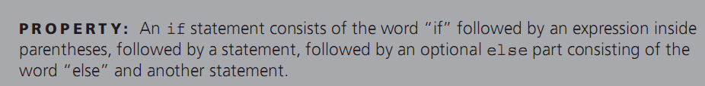
Language Syntax
Written explanations:
Example: if statement in C
Notes:
Issues with this?
Open to interpretation
Wordy
Not everyone speaks English, translation isn’t perfect

Slide 5
Language Syntax
Other forms of Describing:
  1950: Noam Chomsky developed the idea of context-free grammars
    Context-free grammar: A formal specification of syntax which consists of a series of grammar rules
  John Backus and Peter Naur developed a notational system for describing these grammars, now called Backus-Naur forms, or BNFs
  First used to describe the syntax of Algol60

Slide 6
Language Syntax
Three variations of BNF:
  Original BNF
  Extended BNF (EBNF)
  Syntax diagrams

Slide 7
Context-Free Grammars and BNFs
Context-free grammar: A formal specification of syntax which consists of a series of grammar rules
Metasymbols are symbols used to describe the grammar rules
  → is a metasymbol that represents, “can have the form” or “goes to”
  | is a metasymbol to indicate choice
Each rule has a single nonterminal on the left, then an → metasymbol, followed by a sequence of terminals and nonterminals on the right
Nonterminals: The symbol on the left-hand side defined by the sequence of items on the right hand side
Terminals: words or token symbols that cannot be broken down further

Slide 8
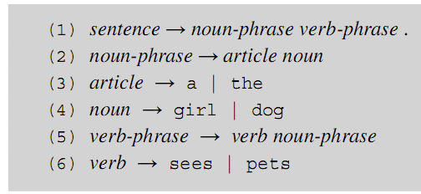
Context-Free Grammars and BNFs
Example: Simple grammar
Metasymbols:
→ separates left and right sides
| indicates a choice

Slide 9
Context-Free Grammars and BNFs
In our simple grammar, sentences consist of a noun phrase and a verb phrase followed by a period
This is expressed by the first grammar rule
Rules 2 – 6 describe the structure of noun phrases, verb phrases, and other nonterminals
The nonterminals on the left-hand side are being described by the sequence of items on the right hand side

Slide 10
Context-Free Grammars and BNFs
Productions: another name for grammar rules
Special symbols in a language can be indicated by “”
  It would be better to have the period in the first rule within quotes as “.”
  This also allows the . to become a metasymbol when not enclosed by quotes.
Some notations use angle brackets as metasymbols
  Example:

Slide 11
Context-Free Grammars and BNFs
A context-free grammar shows us how to generate a syntactically valid string of terminals
Derivation: the process of generating a syntactically valid string of terminals by beginning with the start symbol and replacing left-hand sides by choices of right-hand sides in the rules
Start symbol: a nonterminal representing the entire top-level phrase being defined such as a sentence or program
Language of the grammar: set of all strings of terminals for which there exists a derivation beginning with the start symbol and ending with the string of terminals

Slide 12
Context-Free Grammars and BNFs
A Grammar for a Small Language
  program → begin stmt_list end
  stmt_list → stmt | stmt ";" stmt_list
  stmt → var "=" expression
  expression → var "+" var | var "–" var | var
  var → A | B | C
Leftmost derivation for:
begin A = B + C ; B = C end
Notes:
Do example on board

Slide 13
Leftmost derivation for:
begin A = B + C ; B = C end
program → begin stmt_list end
stmt_list → stmt | stmt ";" stmt_list
stmt → var "=" expression
expression → var "+" var | var "–" var | var
var → A | B | C

Slide 14
Context-Free Grammars and BNFs
Leftmost derivation for:
begin A = B + C ; B = C end
program → begin stmt_list end
→ begin stmt ; stmt_list end
→ begin var = expression ; stmt_list end
→ begin A = expression ; stmt_list end
→ begin A = var + var ; stmt_list end
→ begin A = B + var ; stmt_list end
→ begin A = B + C ;stmt_list end
→ begin A = B + ;stmt end
→ begin A = B + C ; var = expression end
→ begin A = B + C ; B = expression end
→ begin A = B + C ; B = var end
→ begin A = B + C ; B = C end
A Grammar for a Small Language
program → begin stmt_list end
stmt_list → stmt | stmt ";" stmt_list
stmt → var "=" expression
expression → var "+" var | var "–" var | var
var → A | B | C

Slide 15
Context-Free Grammars and BNFs
This grammar has:
  Nine terminals
    (“begin”, “end”, ”;” , ”=” , ”+”,
      ”-”, “A”, “B”, “C”)
  Five nonterminals
  Five grammar rules
  Language is infinite
    In general languages defined by grammars are infinite
    Rule 2 provides the infinite nature of this grammar
A Grammar for a Small Language
program → begin stmt_list end
stmt_list → stmt | stmt ";" stmt_list
stmt → var "=" expression
expression → var "+" var | var "–" var | var
var → A | B | C
Notes:
Explain why the language is infinite

Slide 16
Context-Free Grammars and BNFs
This grammar is:
  Context-free, meaning that nonterminals appear singly on the left-hand sides of grammar rules, which means that each nonterminal can be replaced by any right-hand side choice, no matter where the nonterminal might appear in the language.
    There is no context under which only certain replacements can occur.
  Context-sensitive grammars allow context strings to appear on the left-hand side of the grammar rules
  Context sensitivity can be dealt with semantically

Slide 17
Context-Free Grammars and BNFs
A grammar is context-free when nonterminals appear singly on the left sides of productions
  Grammar for: a^{n}b^{n}
    S -> ???

Slide 18
Context-Free Grammars and BNFs
A grammar is context-free when nonterminals appear singly on the left sides of productions
  Grammar for: a^{n}b^{n}
    S -> ab | aSb
    Is aaabbb described by this grammar?
    aaabbb = aaSbb = aSb = S – so yes!

Slide 19
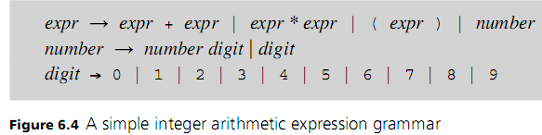
Context-Free Grammars and BNFs
Context-free grammars are the norm for expressing languages and make it easier to write translators
Allow the parsing stage to be automated
Context sensitivity can be dealt with semantically
Example:
Note the recursive nature of the rules
Notes:
So the derivations we just did on the board can be done by a computer with ease

Slide 20
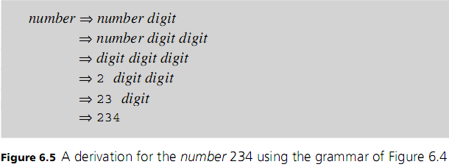
Context-Free Grammars and BNFs
Example:

Slide 21
Lexical Structure of Programming Languages
Terminals can be formally described by regular expressions
Regular expressions are descriptions of patterns of characters
Regular expressions have three basic operations:
  Concatenation: done by sequencing the items without an explicit operation, parentheses can be included to allow for grouping of operations
  Repetition: indicated by an asterisk/plus after the item to be repeated
  Choice or selection: indicated by a vertical bar between items to be selected
Ex: (a | b)* c → 0 or more repetitions of choice a or b followed by c (concatenation)
Notes:
Concatenation: () can be included to allow for grouping of operations
Repetition: * or + after the item to be repeated
Choice or selection: | between items to be selected

Slide 22
Lexical Structure of Programming Languages
Ex: (a | b)* c → 0 or more repetitions of choice a or b followed by c (concatenation)
  String that match this regular expression could include:
    ababaac, aac, babbc, c
  String that do not match this regular expression could include:
    aaabaa, bca
Notes:
Concatenation: () can be included to allow for grouping of operations
Repetition: * or + after the item to be repeated
Choice or selection: | between items to be selected

Slide 23
Lexical Structure of Programming Languages
Regular expressions notation can be extended by additional operations and special characters to make them easier to write:
  Square brackets with a hyphen ([-]) indicate a range of characters
  Question mark (?) indicates an optional item
  Period (.) Wildcard: indicates any character
  Escaping a character (\) (if you need to use a symbol that has special meaning such as ?)
  Ex: [0 – 9]+ indicates simple integer constants consisting of one or more digits between 0 and 9
  Ex: [0 – 9]+(\.[0 – 9]+)? describes simple (unsigned) floating-point literals
Notes:
Concatenation: () can be included to allow for grouping of operations
Repetition: * or + after the item to be repeated
Choice or selection: | between items to be selected
Square brackets with a hyphen ([-]) indicate a range of characters
Question mark (?) indicates an optional item
Period (.) indicates any character
Escaping a character (\) (if you need to use a symbol that has special meaning such as ?)

Slide 24
Regular Expressions
What are some strings from this regular expression:
  [0 – 9]+((E|e)(\+|\-)?[0 – 9]+)?
Notes:
Concatenation: () can be included to allow for grouping of operations
Repetition: * or + after the item to be repeated
Choice or selection: | between items to be selected
Square brackets with a hyphen ([-]) indicate a range of characters
Question mark (?) indicates an optional item
Period (.) indicates any character
Escaping a character (\) (if you need to use a symbol that has special meaning such as ?)

Slide 25
Regular Expressions
What are some strings from this regular expression:
  [0 – 9]+((E|e)(\+|\-)?[0 – 9]+)?
    42
    42e2
    42E-02
    0e+111
Notes:
Concatenation: () can be included to allow for grouping of operations
Repetition: * or + after the item to be repeated
Choice or selection: | between items to be selected
Square brackets with a hyphen ([-]) indicate a range of characters
Question mark (?) indicates an optional item
Period (.) indicates any character
Escaping a character (\) (if you need to use a symbol that has special meaning such as ?)

Slide 26
Regular Expressions
Write a regular expression for C identifiers consisting of letters, digits, and the underscore character ‘_’, and starting with a letter or underscore
Notes:
Concatenation: () can be included to allow for grouping of operations
Repetition: * or + after the item to be repeated
Choice or selection: | between items to be selected
Square brackets with a hyphen ([-]) indicate a range of characters
Question mark (?) indicates an optional item
Period (.) indicates any character
Escaping a character (\) (if you need to use a symbol that has special meaning such as ?)

Slide 27
Regular Expressions
Write a regular expression for C identifiers consisting of letters, digits, and the underscore character ‘_’, and starting with a letter or underscore
  [a-zA-Z_][a-zA-Z0-9_]*
Notes:
Concatenation: () can be included to allow for grouping of operations
Repetition: * or + after the item to be repeated
Choice or selection: | between items to be selected
Square brackets with a hyphen ([-]) indicate a range of characters
Question mark (?) indicates an optional item
Period (.) indicates any character
Escaping a character (\) (if you need to use a symbol that has special meaning such as ?)

Slide 28
Regular Expressions & BNF
Valid sentences:
  A person runs a marathon
  A bank looses the money
  And key writes and xyz
Invalid sentences
  My bank loses the money
sentence → noun-phrase verb-phrase
noun-phrase → article noun
article → a | and | the
noun → [A-Za-z]+
verb-phrase → verb noun-phrase
verb → [A-Za-z]+
Notes:
We use the principle of longest substring implicitly here

Slide 29
Regular Expressions & BNF
  program → begin stmt_list end
  stmt_list → stmt | stmt ";" stmt_list
  stmt → var "=" expression
  expression → var [^\w\s]+ var | var
  var → A | B | C
Valid sentences:
  begin A = B == C end
  begin C = A % B + B end
  begin B = B && C || B && A; A = A end
  begin C = A % B == C end
Notes:
We use the principle of longest substring implicitly here

Slide 30
Regular Expressions & BNF
  program → begin stmt_list end
  stmt_list → stmt | stmt ";" stmt_list
  stmt → var "=" expression
  expression → var [^\w\s]+ var | var
  var → [\w\W]+
Valid sentences:
  N/A
Notes:
The \W (Not word) does us in because it makes the grammar ambiguous, which we will talk about more in a later lecture
The grammar is ambiguous because var’s can have spaces and symbols, so we can’t disambiguate (or tell apart) a var from an expression

Slide 31
Regular Expressions & BNF
  program → begin stmt_list end
  stmt_list → stmt | stmt ";" stmt_list
  stmt → var "=" expression
  expression → var [^\w\s]+ var | var
  var → [A-Za-z0-9]+
Valid sentences:
Notes:
Or \w

